Slide 1

Users in Powershell

Slide 2
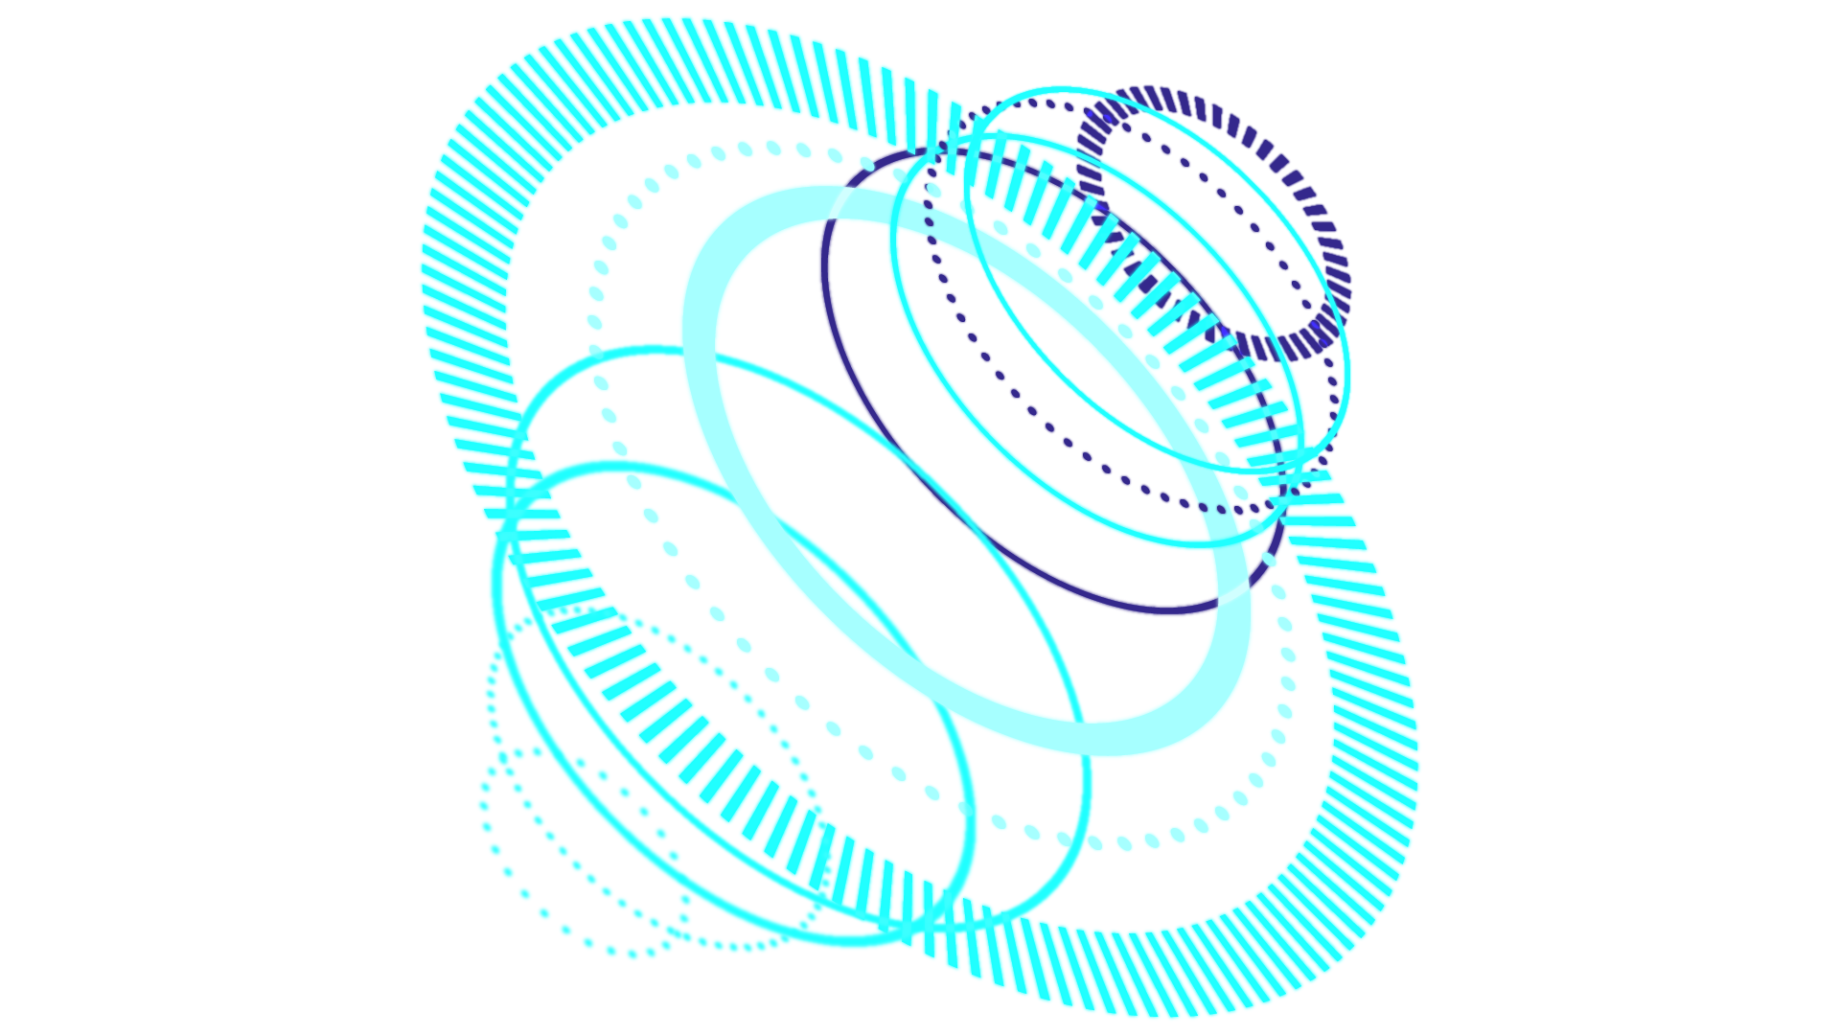
TABLE OF CONTENTS
Users
01
User Settings
02
How to edit users
03
Listing, Adding, and Removing Users
How to add or remove users from the computer and groups
how to edit user settings in powershell

Slide 3


Users
local accounts on your computer that have access to files, policies and applications

Slide 4
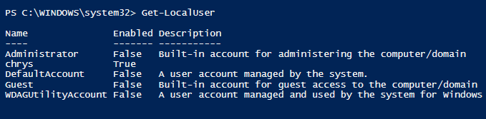
Listing Users
Get-LocalUser
will list all the local users on the system

Slide 5
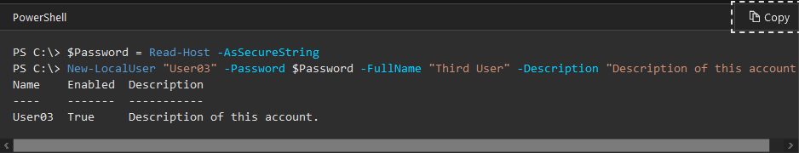
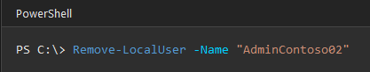
How to add and remove users
use New-LocalUser to add a new user
use Remove-LocalUser to remove a local user

Slide 6
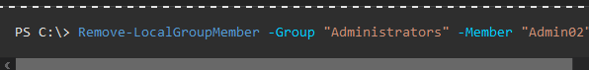
How to add and remove users from a group
use Add-LocalGroupMember to add a local user to a group
use Remove-LocalGroupMember to remove a user from a group

Slide 7
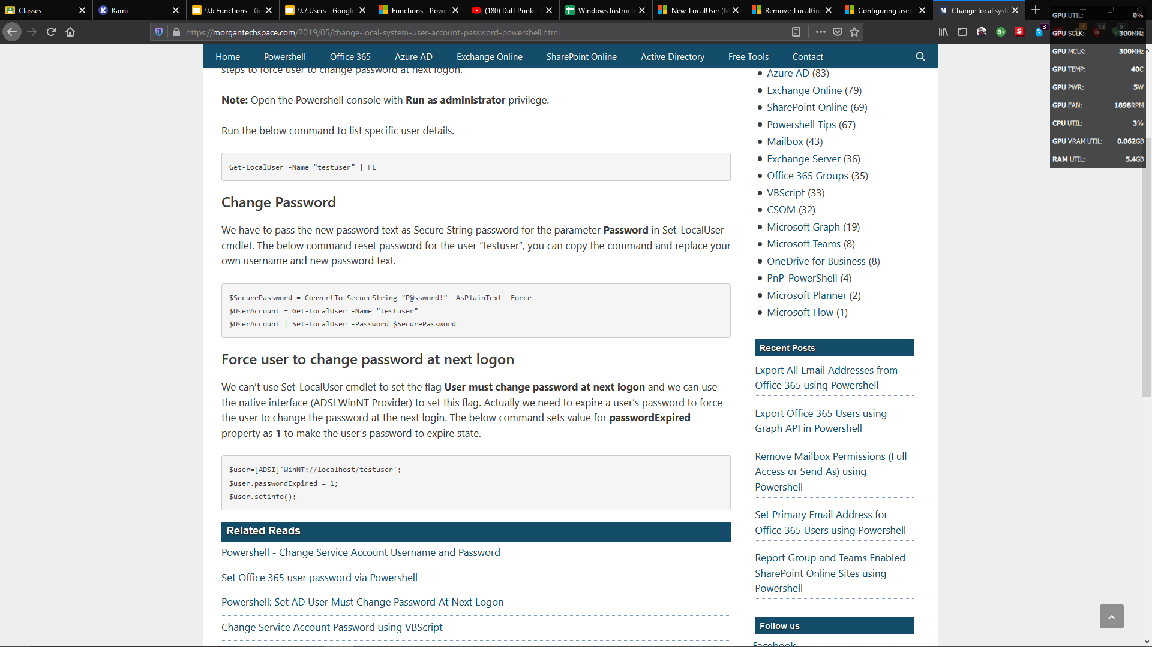
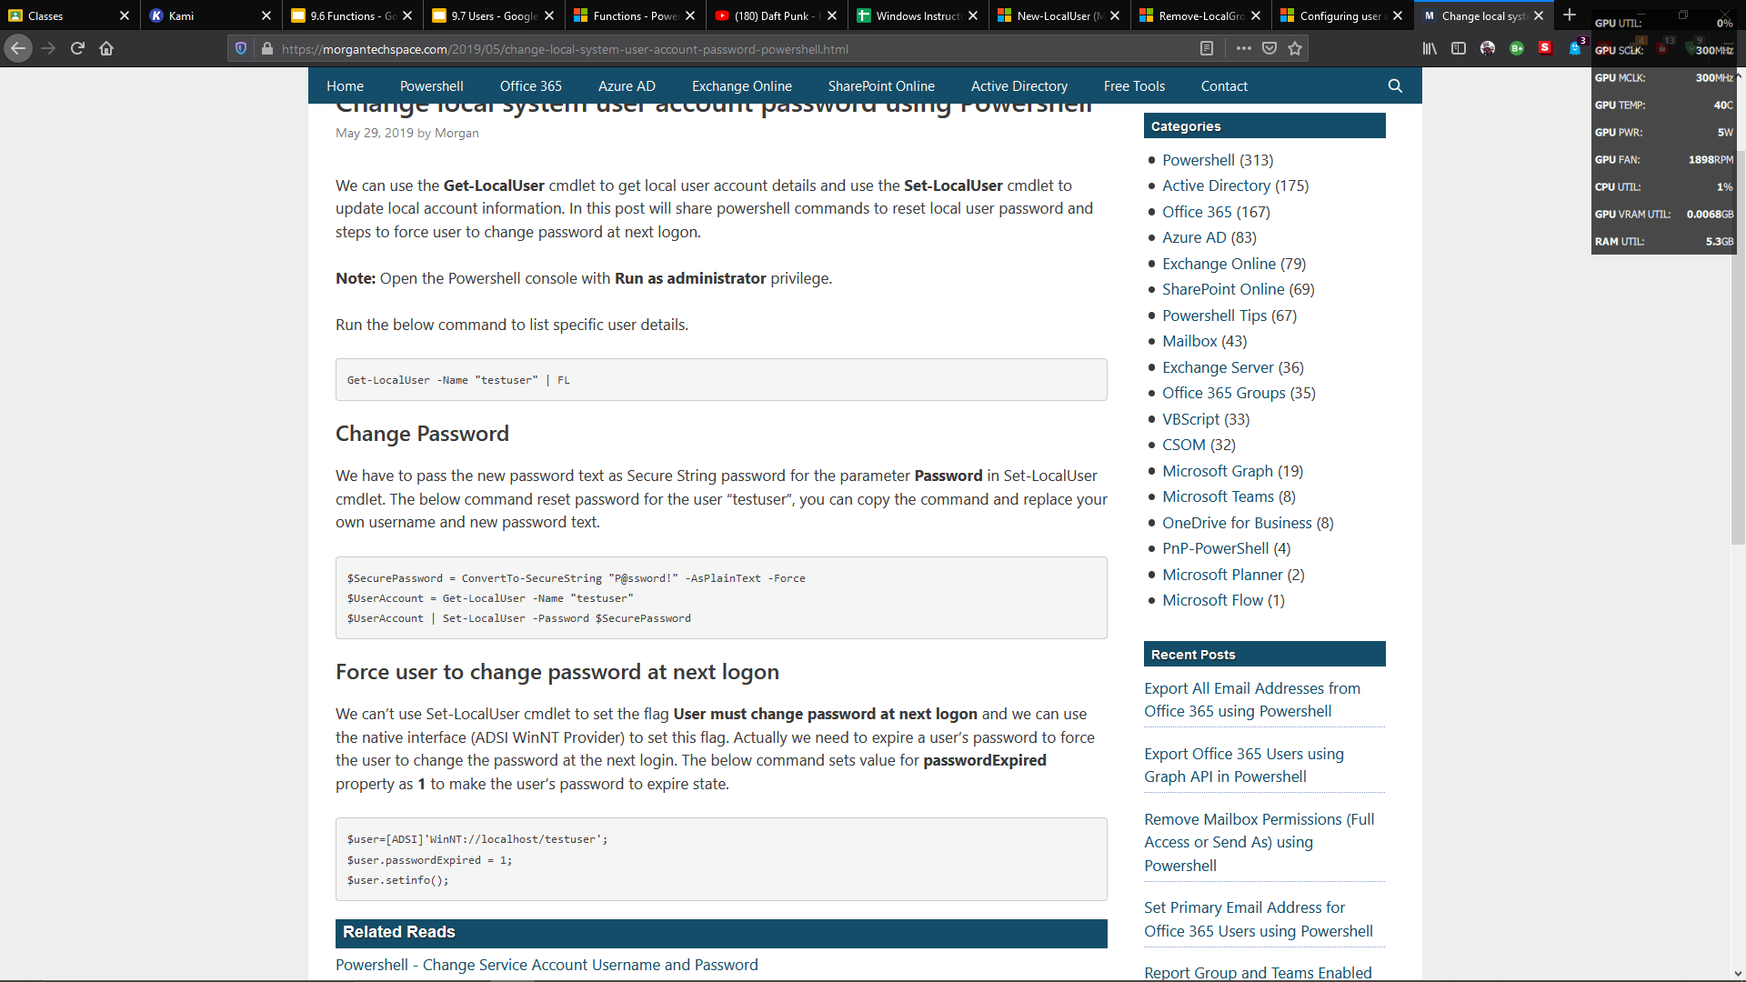
How to edit users
$SecurePassword = ConvertTo-SecureString "P@ssword!" -AsPlainText -Force
$UserAccount = Get-LocalUser -Name "testuser"
$UserAccount | Set-LocalUser -Password $SecurePassword

Slide 8
Slides made by Zachary Dang
product of 1 am work so don't judge

Slide 9


